Slide 1
Shrimati Narsamma Hirayya Shaikshanik Trusts’s
Smt. Narsamma Arts, Commerce and Science College, Kiran Nagar Amravati
Information of Silver Jubilee Year programme : 2020-2021

Slide 2
Sr. No. | Programme organized by | Name of Programme | Programme Level | Date of Program | Duration | No. of Participants
01 | Botany | Holi colour making Workshop | State Level | 22.3.2021 | One Day | 51
 |  | e-magazine “The Plantsman publication in each months” Information of 25 different plants | State Level | 25-09-2020 onwards | Monthly | Community Publication
02 | Chemistry | International Webinar on Innovations in Science and Technology | International Level | 27.02.2021 | One Day | 3757
03 | Co-curricular Committee | Scientific Talk & Inter-Collegiate Poster Competition | State Level | 16.10.2020 | One Day | 92
 |  | Popular Talk on the Occasion of NSD - 2021 | State Level | 28.2.2021 | One Day | 98
04 | Eco-club (Joint venture of Botany & EVS Dept.) | Night Jungle Safari on the Occasion of World Wildlife Day - 2021 | State Level | 03.3.2021 | One Day | 59
 |  | Wild life awareness online Quiz | State Level | 13-11-2020 | One Day | 78
 |  | Wild life awareness online Quiz | State Level | 02 to 08 Oct, 2020 | One Week | 369
 |  | Digital Poster Making/ Drawing Competition Slogan Preparation Competition | Inter-Collegiate | 22.3.2021 | One Day | 31

Slide 3
Sr. No. | Programme organized by | Name of Programme | Programme Level | Date of Program | Duration | No. of Participants
05 | Computer Science | A 7 Days Expert Talk Series | State Level | 01 To 07 Feb. 2021 | One Week | 157
06 | Economics | Economic Nationalism of India | State Level |  | One Day | 87
07 | English | Books Distribution At Sadashanti Balgruh | College Level |  | One Day | 65
08 | Faculty Development Committee | One day practical workshop on how to deal with emotions. | College Level |  | One Day | 30
09 | Library | Useful e Resources and Academic Integrity | National level |  | One Day | 478
10 | Marathi | Kavisamelan | College Level | 05-03-2021 | One Day | 82
11 | Mathematics | National Level Webinar on Career Prospects in Mathematics | National level | 27-01-2021 | One Day | 338
 |  | National Level Quiz Competition | National Level | 27-01-2021 | One Day | 196

Slide 4
Sr. No. | Programme organized by | Name of Programme | Programme Level | Date of Program | Duration | No. of Participants
12 | NSS | Blood Donation | Local Level |  | One Day | 64
 |  | National Level Swami Vivekananda General Knowledge Quiz | National Level |  | One Day | 65
13 | Physics | An Enrichment Activity For Kids | City / Local Level | 22-03-2021 | One Day | 104
 |  | Birth Anniversary of Ex-President Dr. APJ Kalam | National Level | 15-10-2020 | One Day | 145
 |  | Third flower of Stephen Hawking Lecture Series | National Level | 14-02-2021 | One Day | 121
14 | Women Cell & MTN Committee | One day State level Webinar | State Level | 03-01-2021 | One Day | 45
15 | Industrial Chemistry | National Level Poster Competition on Non Conventional Energy Sources | National Level | 22-31 March 2021 | One Day | 51

Slide 5
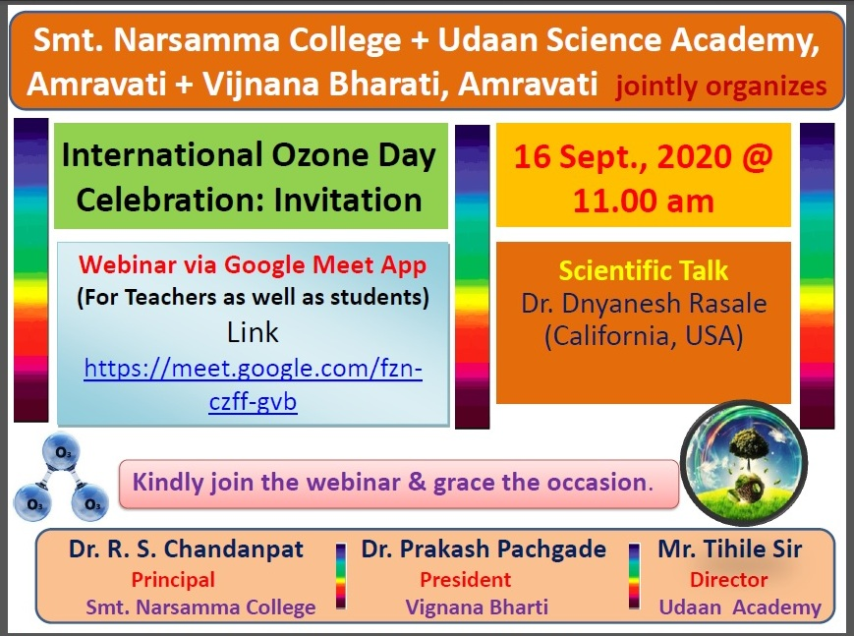
One Day State Level Scientific Talk & Inter-Collegiate Poster Competition Organized by Co-curricular Committee
One Day State Level Holi colour making Workshop Organized by Department of Botany.

Slide 6
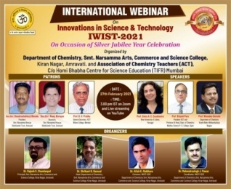
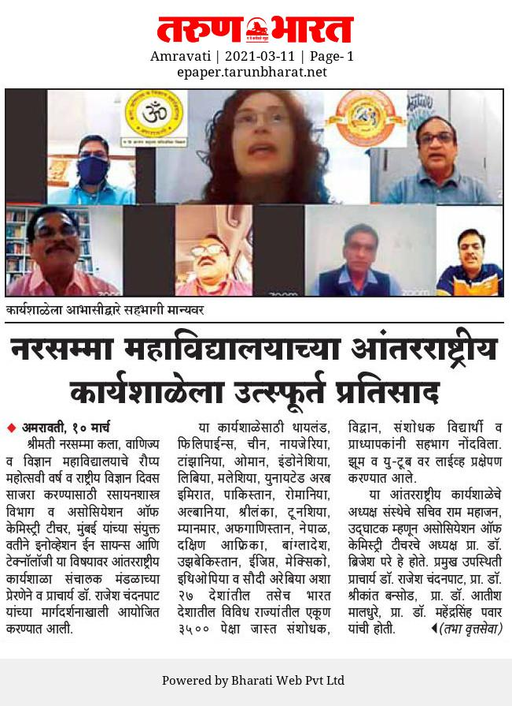
International Webinar on Innovations in Science and Technology Organized by Department of Chemistry

Slide 7
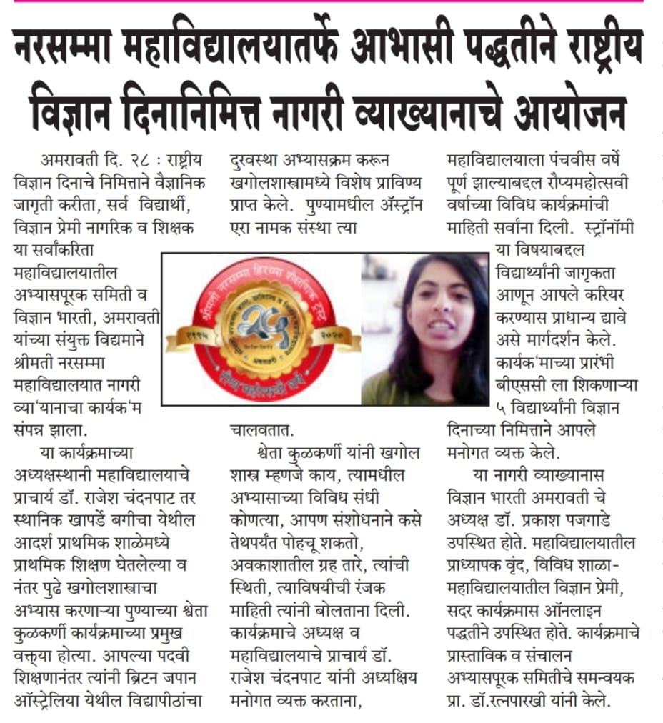
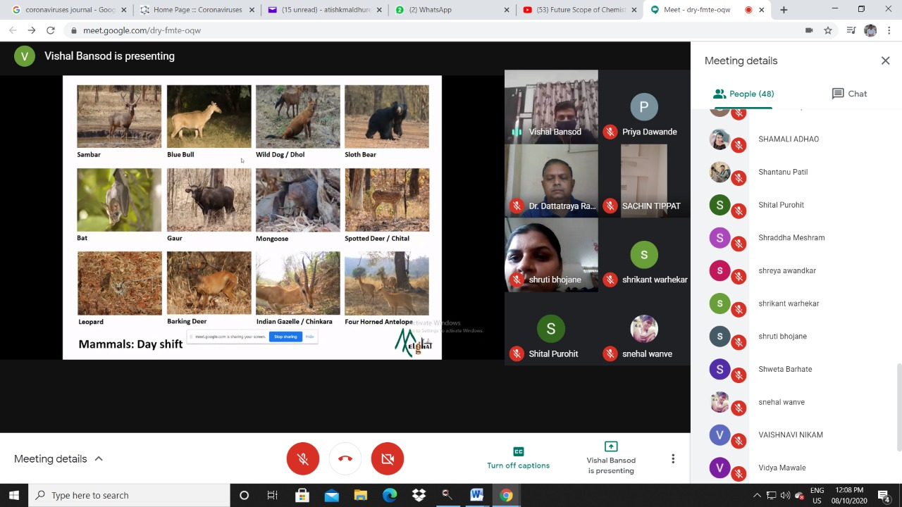
Popular Talk on the Occasion of NSD– 2021 Organized by Co-curricular Committee
Night Jungle Safari on the Occasion of World Wildlife Day – 2021 organized by Eco-club (Joint venture of Botany & EVS Dept.)

Slide 8
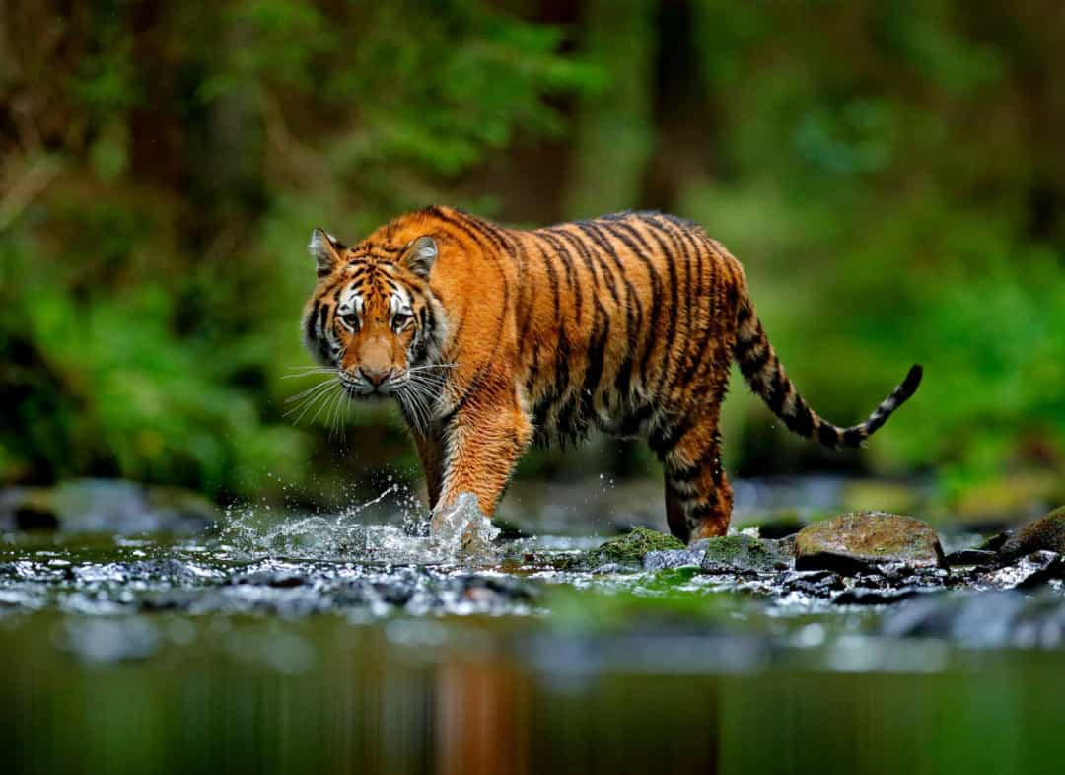
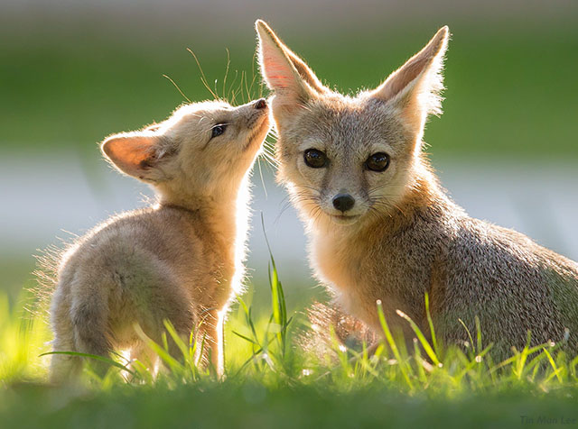
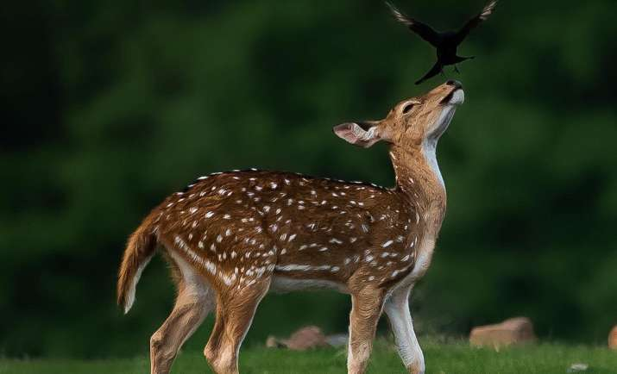
World Wildlife Day Online Night Jungle Safari on - 03.3.2021 @ 7.30 pm
*Guest Speaker*
Mr. Manish Dhakulkar
Field Biologist associated with Adventure Hub, Amravati.
Organized by
Eco-club
Smt. Narsamma College , Kiran Nagar, Amravati
(Joint Venture of Botany & Envi. Science Department)

Slide 9
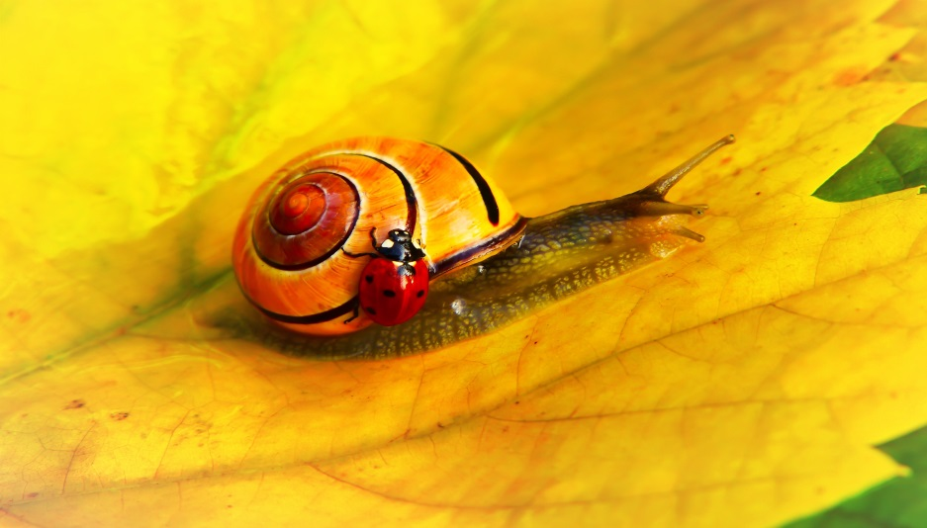
Wildlife Awareness Quiz
Jointly Organized by
Smt. Narsamma College & Wildlife Environment & Conservation Society (WECS), Amravati

Slide 10
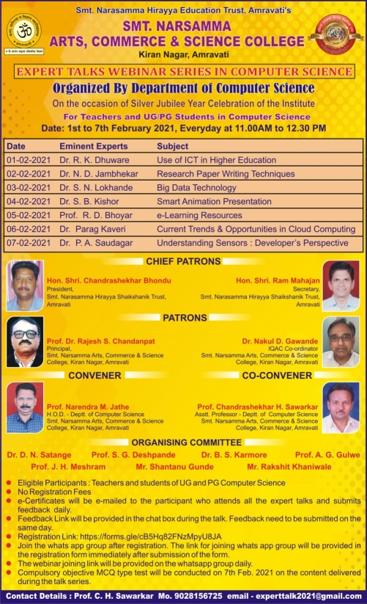
Day# | Topic | Resourcs Person (Expert) | Designation and Workplace | Session Chair | Designation and Workplace | No. of Participants
Day 1 | Use of ICT in Higher Education | Prof. Dr. Rakesh. K. Dhuware | Head, Department of Computer Science, DhoteBandhu Science College, Gondia | Prof. N. M. Jathe | Head, Department of Computer Science | 157
Day 2 | Research Paper Writing Techniques | Prof. Dr. N. D. Jambhekar | Head, Department of Computer Science, Smt. Gopikabai Sitaram Gawande College, Umarkhed, Dist. Yavatmal | Prof. C. H. Sawarkar | Asst. Prof., Department of Computer Science | 143
Day 3 | Big Data Technology | Dr. S. N. Lokhande | Assistant Professor, School of Computational Sciences, SRTM University, Nanded | Mr. Prashant K. Ladole | Principal IT Architect, Morgan Stanley, Menlo Park, California (US) | 122
Day 4 | Smart Animation Presentation | Prof. S. B. Kishor | Head, Department of Computer Science, Sardar Patel Mahavidyalaya, Chandrapur | Prof. Mukul M. Bhonde | Asst. Professor, Department of Computer Science, Sheri Shivaji Science College, Amravati | 125
Day 5 | e-Learning Resources | Prof. Rajesh D. Bhoyar | Assistant Professor, Post Graduate Department of Computer Science, Sant Gadge Baba Amravati University, Amravati | Mr. T. N. Shivkumar | Senior Director, Zensar Inc. San Jose, California (US) | 111
Day 6 | Current Trends & Opportunities in Cloud Computing | Dr. Parag Ravikant Kaveri | Assistant Professor and Program Head for MSc, Symbiosis Institute of Computer Studies and Research, Pune | Mr. Akash Dalal | Customer Data Platform (CDP) & Customer 360, Strategist Associate Director, Cognizant Technology Solution, Texas, USA | 118
Day 7 | Understanding Sensors: Developer’s Perspective | Prof. Dr. P. A. Saudagar | Professor, Department of Electronics, Shiksha Mandal’s Bajaj College of Science, Wardha | Prof. Dr. D. S. Dhote | Principal, Brijlal Biyani Science College, Amravati | 106
State Level One Week Expert Talk Series organized by Department of Computer Science

Slide 11
State Level workshop on Economic Nationalism of India organized by Department of Economics

Slide 12
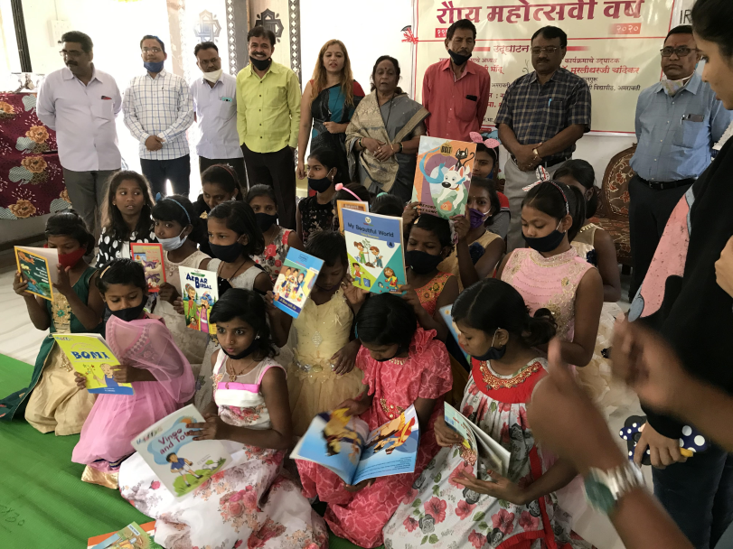
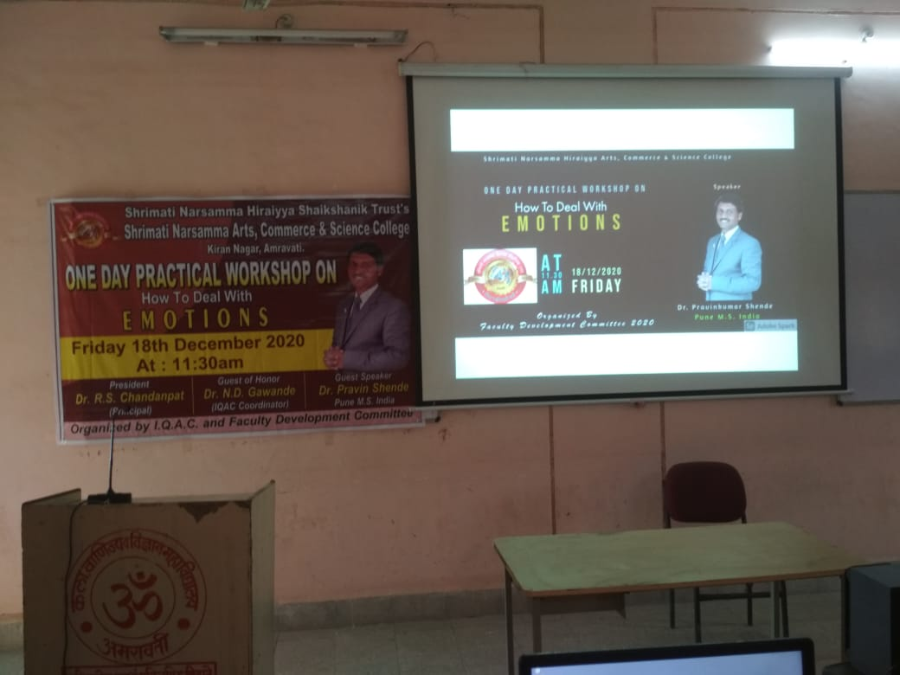
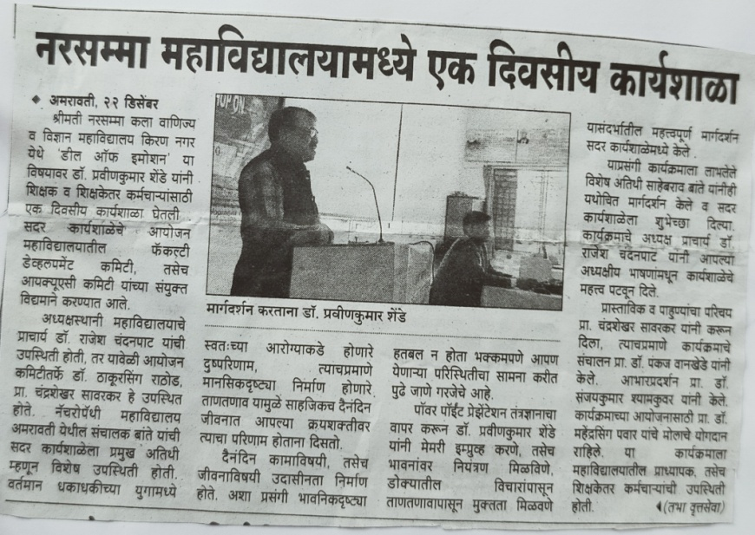
One day College Level practical workshop on how to deal with emotions. by Faculty Development Committee
College Level Program on Books Distribution At Sadashanti Balgruh organized by Department of English
One day College Level practical workshop on how to deal with emotions. by Faculty Development Committee

Slide 13
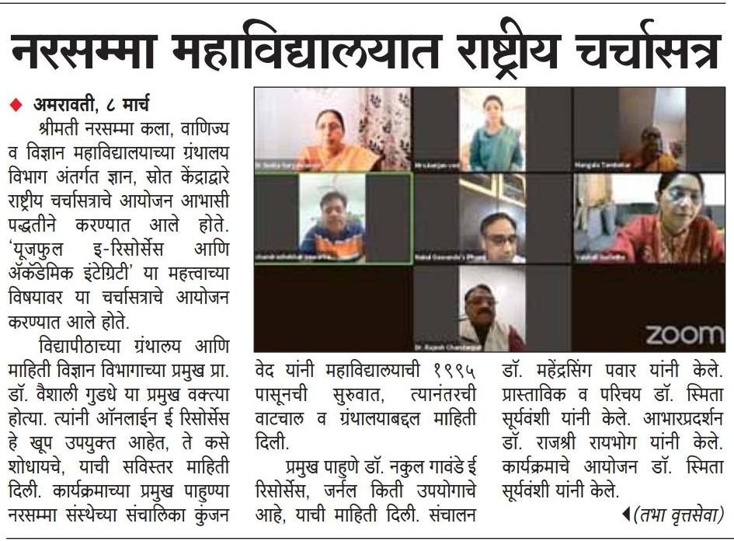
One Day National level Workshop on Useful e Resources and Academic Integrity organized by Central Library of the College.

Slide 14
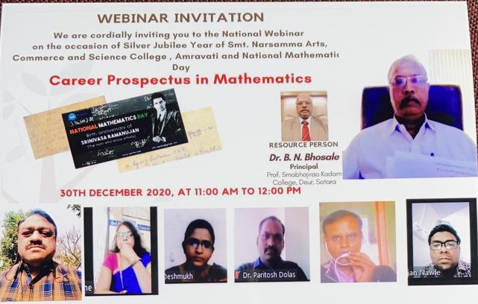
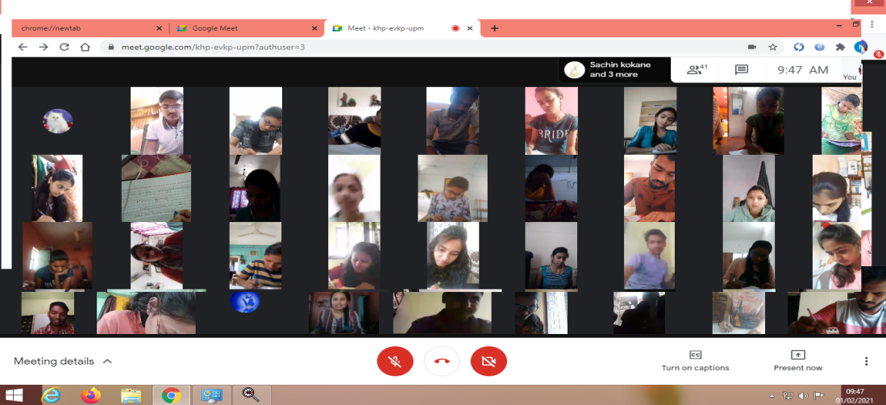
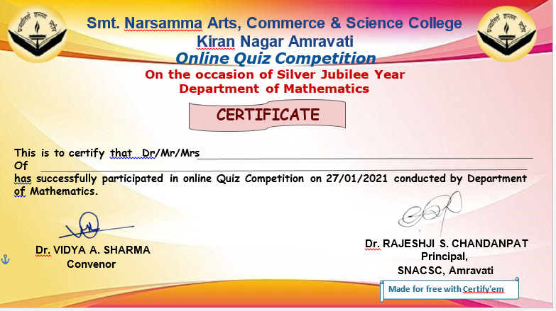
One Day National level National Level Webinar on Career Prospects in Mathematics and National Level Quiz Competition for PG and UG students organized by Department of Mathematics

Slide 15
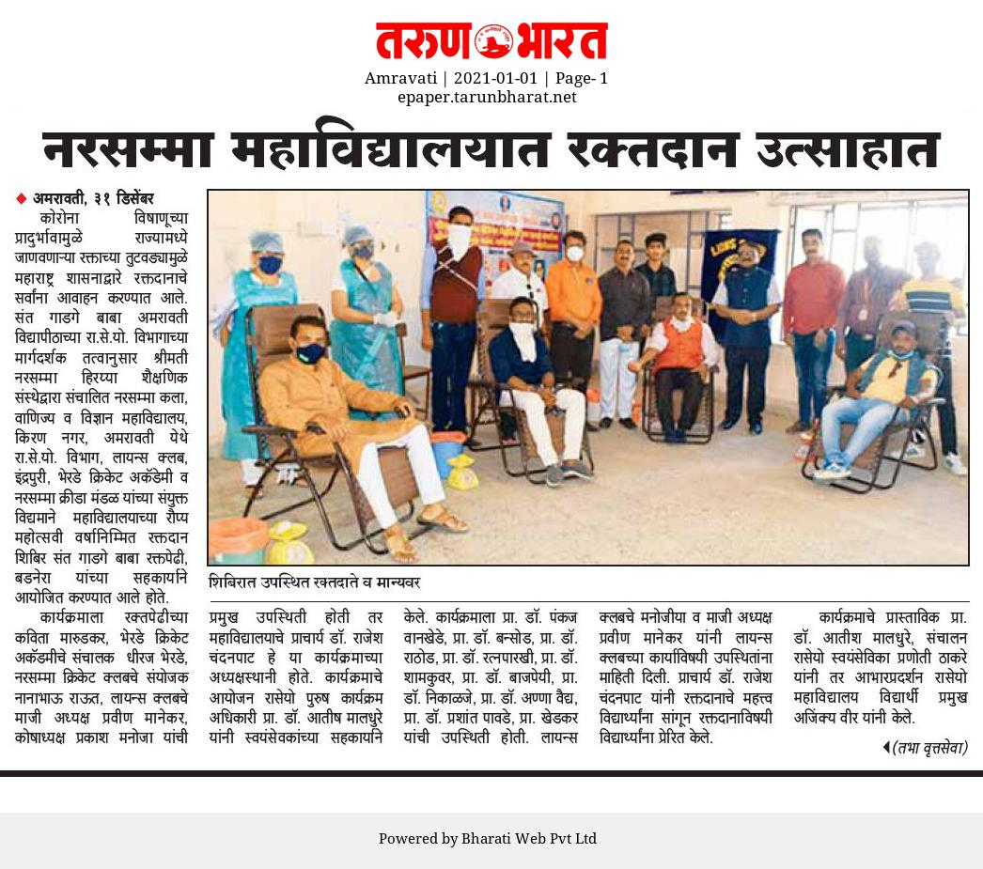
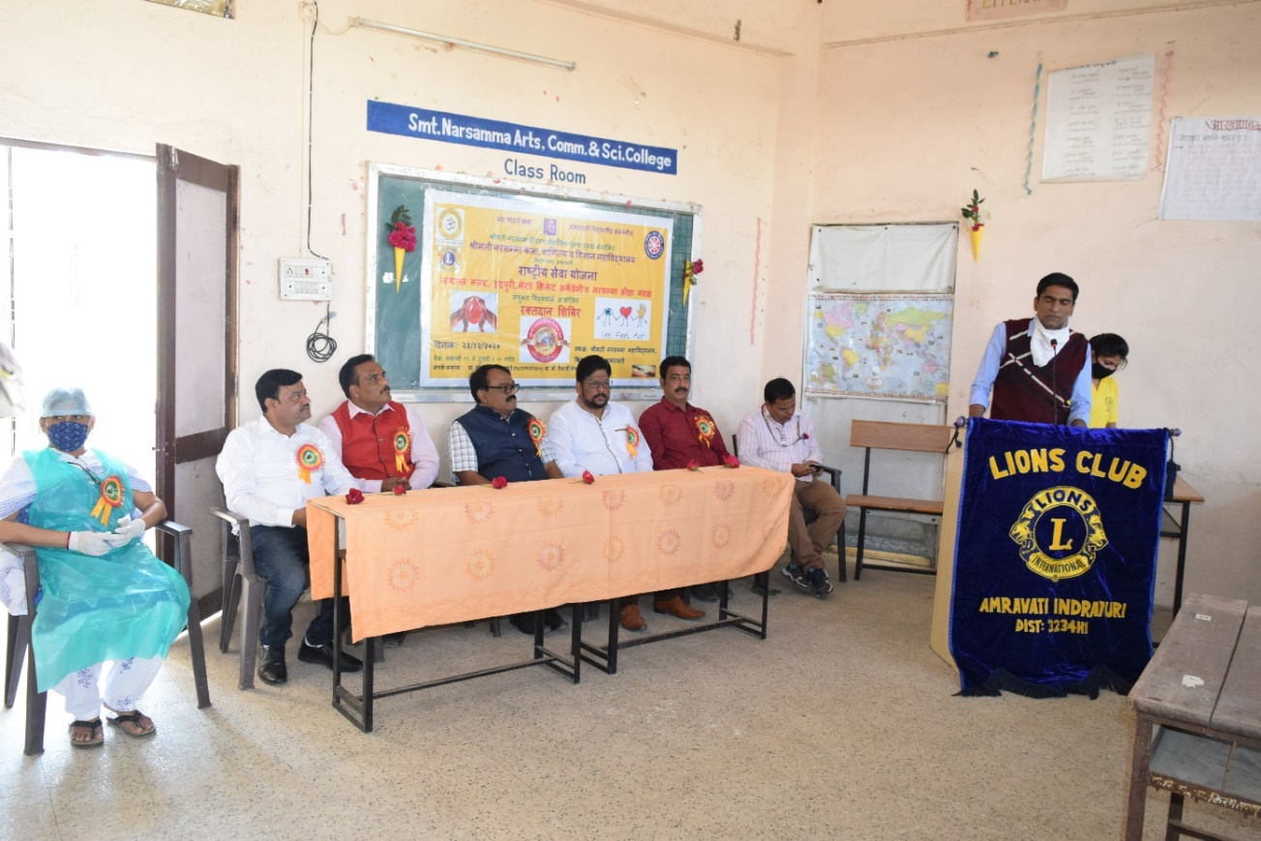
One Day Local Level Blood Donation Camp Organized by NSS

Slide 16
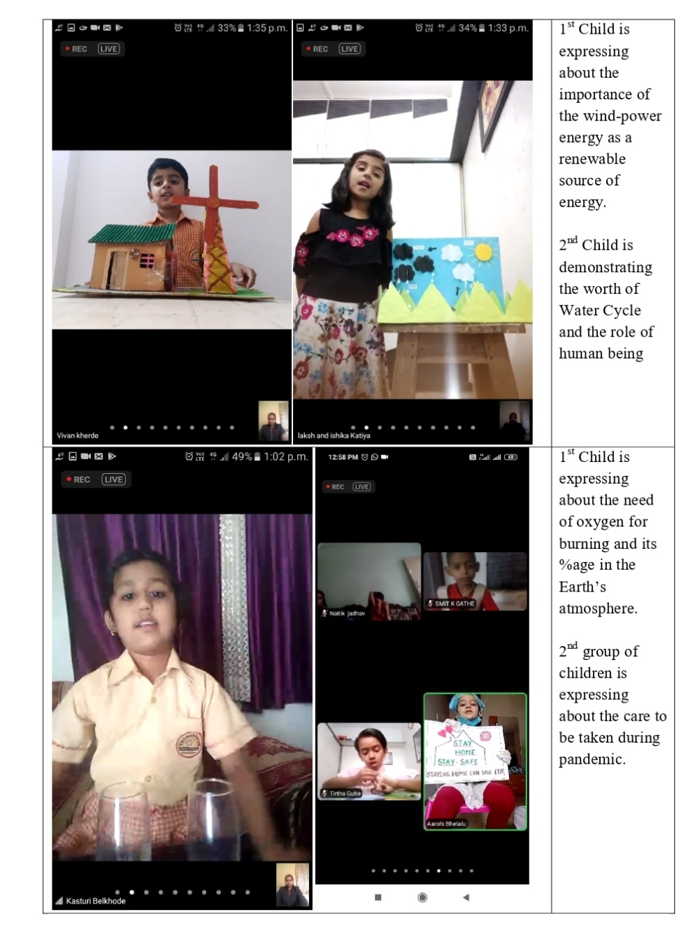
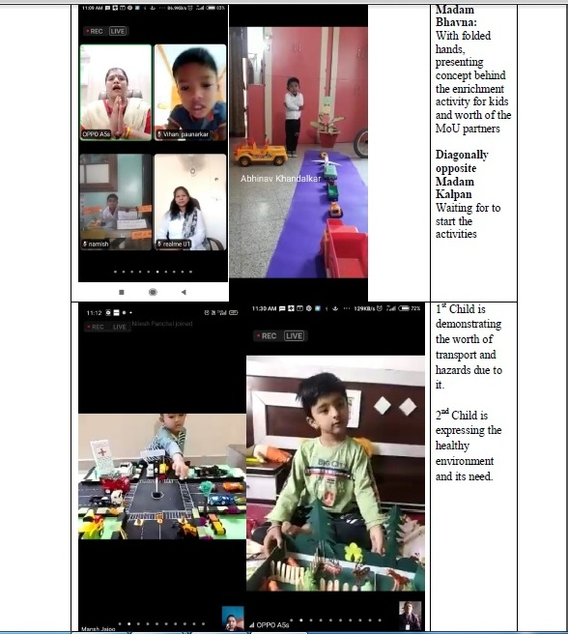
City / Local Level Program on An Enrichment Activity For Kids organized by Department of Physics

Slide 17
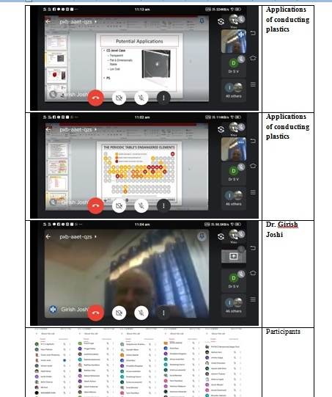
One Day National Level Third flower of Stephen Hawking Lecture Series and Birth Anniversary of Ex-President
Dr. APJ Kalam organized by Department of Physics

Slide 18
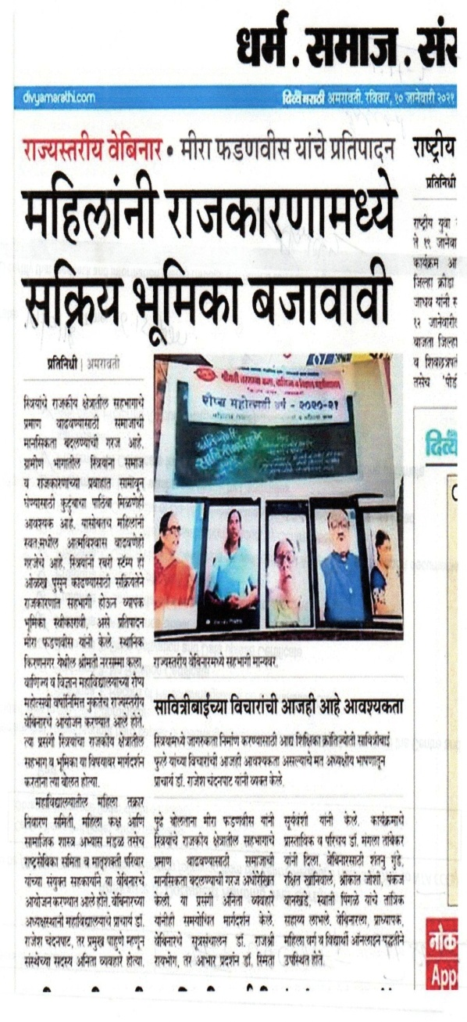
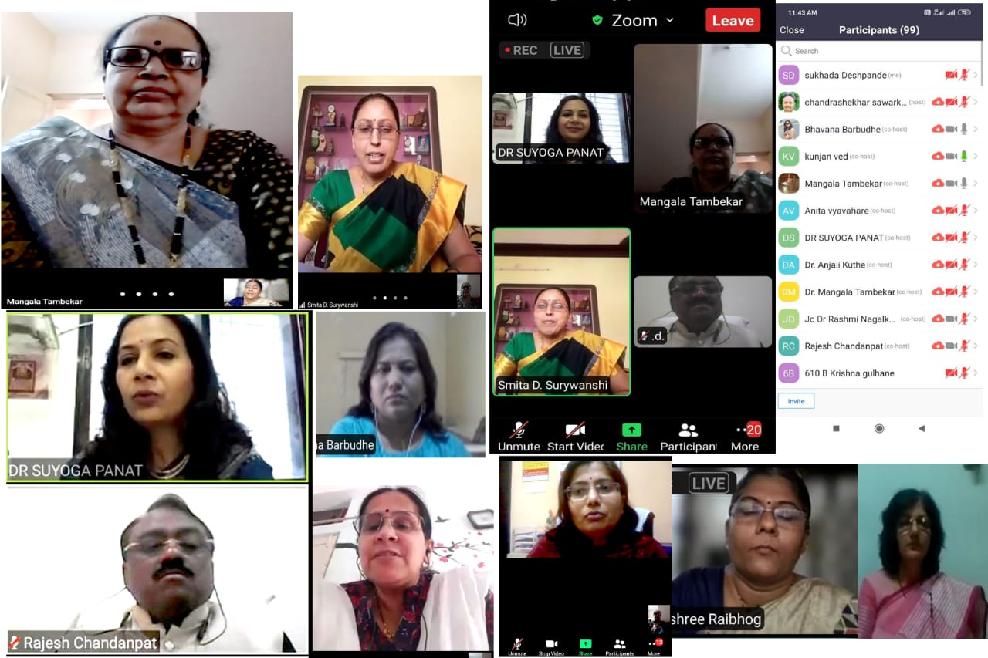
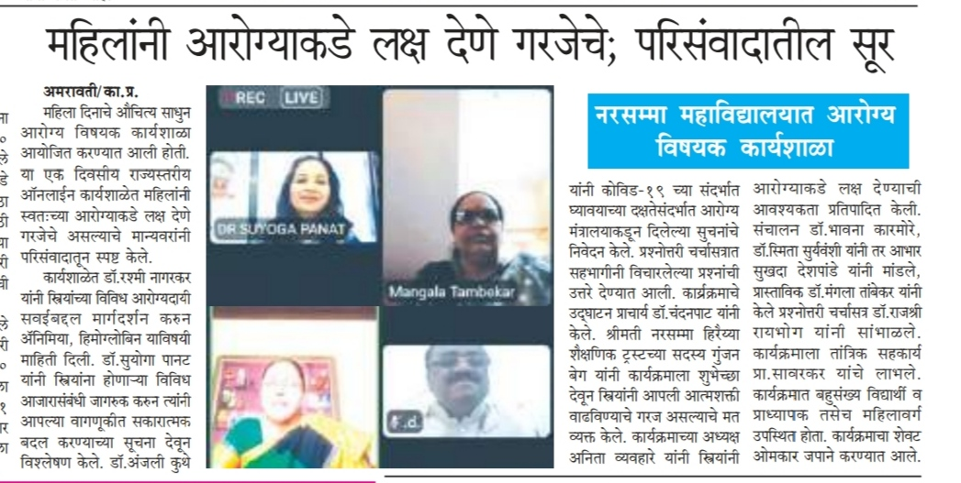
One Day State Level Webinar organized by Women Cell & MTN Committee

Slide 19
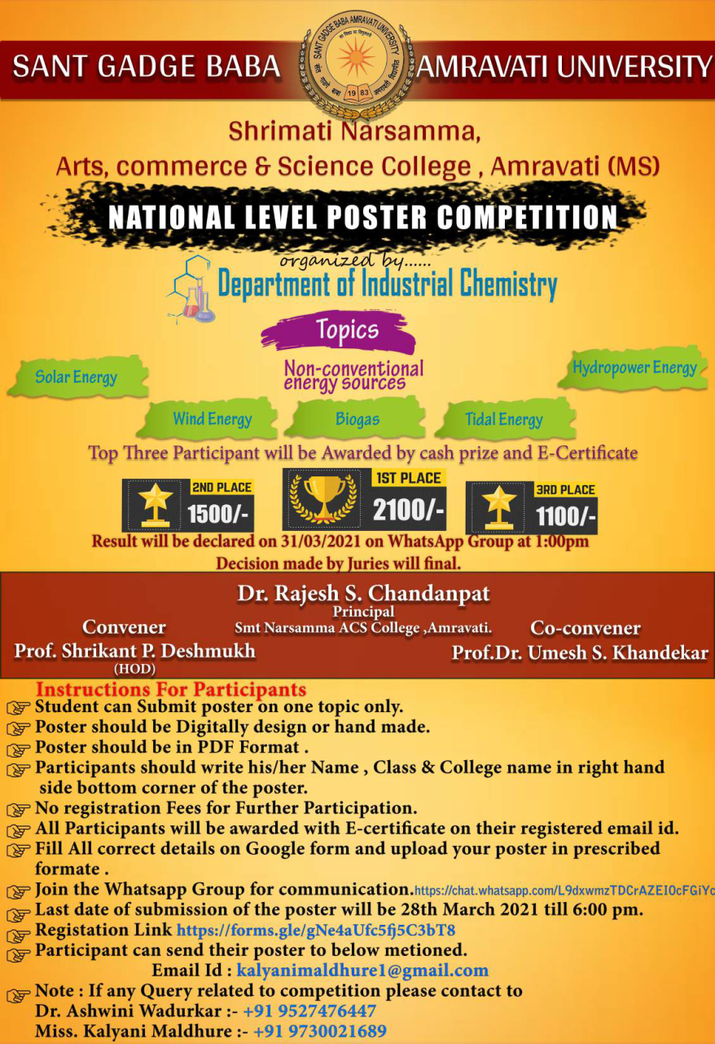
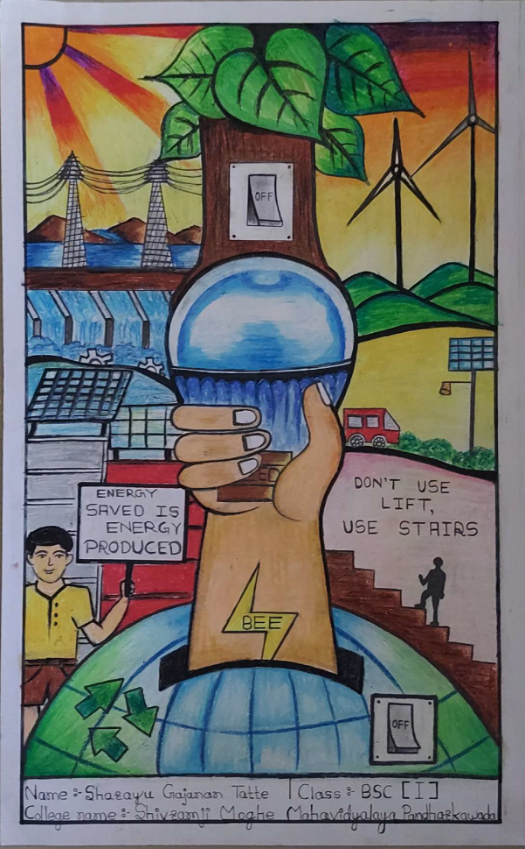
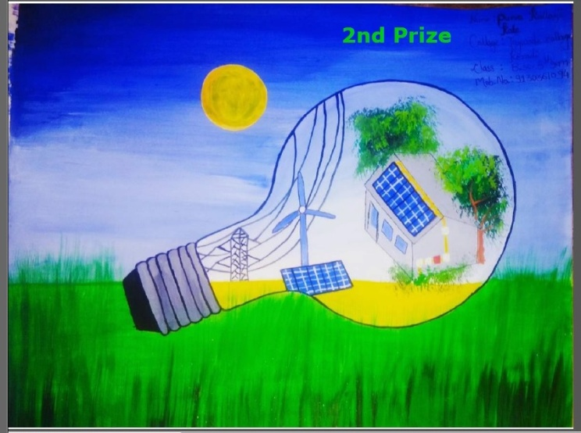
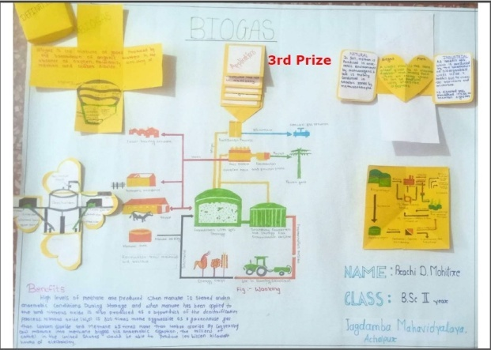
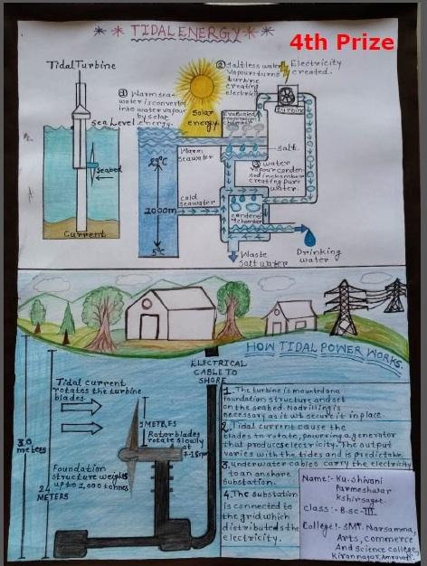
National Level Poster Competition on Non Conventional Energy Sources organized by Industrial Chemistry

